Slide 1

Give each statement a score out of 5: 1 = Totally agree 5 = Totally disagree
I can explain fully what the term ‘Climate Change’ means.
The earth’s climate is changing and we need to do something to stop it.
I have a personal responsibility to protect the planet.
I love planet earth.
Everyone is equally affected by climate change.

Slide 2
This half term:
The Earth’s story
Stories of hope
Climate Stories
Religious Stories
Your story

Slide 3


What is the earth’s climate story?
What is the earth’s climate story?
Success Criteria - I can:
- Describe how climate change is affecting the earth.
- Reflect thoughtfully on my response to this information.
Key Terms
Earth
Climate Change
Environment
Impact

Slide 4
Look carefully at the set of sources you have been given.
What is the earth’s climate story?
For the picture:
How does this picture make you feel about our planet?
For the map / graph:
What does this tell you about climate change?
For the story:
What do you think the person would say about climate change?
Success Criteria - I can:
- Describe how climate change is affecting the earth.
- Reflect thoughtfully on my response to this information.
Key Terms
Earth
Climate Change
Environment
Impact

Slide 5
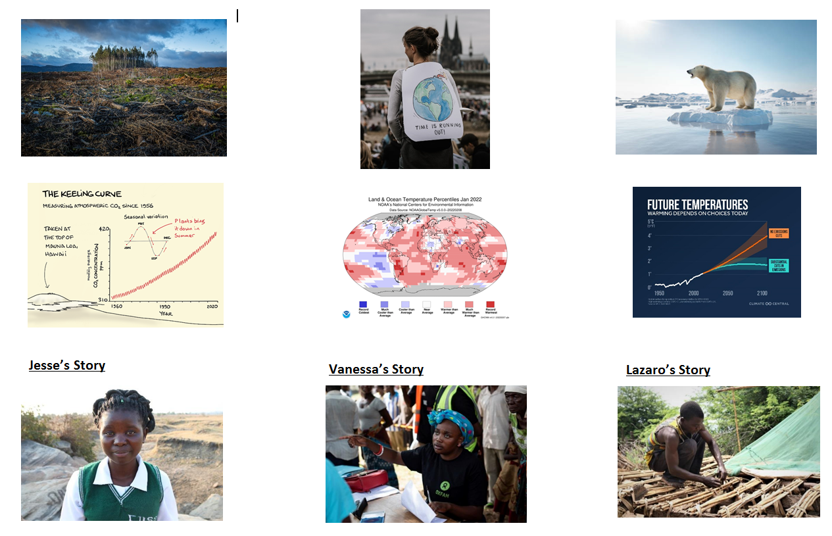

Slide 6
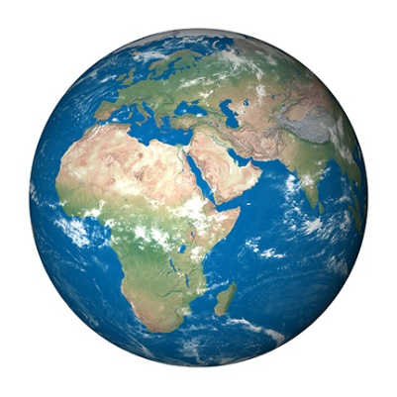
If the earth could speak, what would it say?
What is the earth’s climate story?
Success Criteria - I can:
- Describe how climate change is affecting the earth.
- Reflect thoughtfully on my response to this information.
What is the earth’s story?
Key Terms
Earth
Climate Change
Environment
Impact

Slide 7
What is the earth’s climate story?
What is climate change and global warming?
Success Criteria - I can:
- Describe how climate change is affecting the earth.
- Reflect thoughtfully on my response to this information.
What are the causes and impacts?
Key Terms
Earth
Climate Change
Environment
Impact

